Slide 1
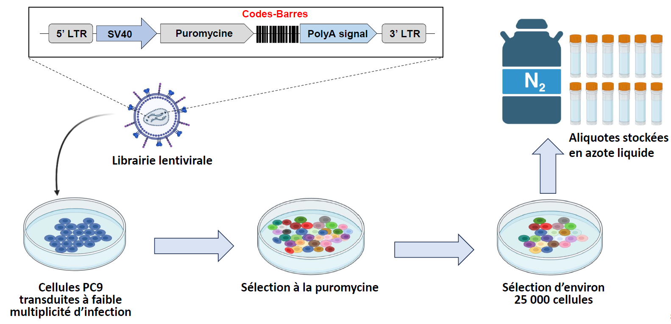

Slide 2
Workflow
-eliminate barcodes for which the combined counts of the 4 controls are <5
-normalize barcodes so that total number of counts is 100 000
-calculate mean of the 4 controls
-calculate the fold change vs control (mean) for each drug replicate
-if fc>3 🡪 1, if not 🡪 0
Osimer1_100n_exp010821_run180821_07 | Osimer2_100n_exp010821_run180821_08 | Osimer3_100n_exp010821_run180821_09 | Osimer4_100n_exp010821_run180821_10 | , | Osimer1_100n_exp010821_run180821_07 | Osimer2_100n_exp010821_run180821_08 | Osimer3_100n_exp010821_run180821_09 | Osimer4_100n_exp010821_run180821_10 | Osimer_100n_exp010821_run180821
0,31 | 0,25 | 0,34 | 0,34 |  | 0 | 0 | 0 | 0 | 0
0,27 | 0,19 | 0,33 | 0,24 |  | 0 | 0 | 0 | 0 | 0
5,44 | 4,50 | 5,44 | 4,78 |  | 1 | 1 | 1 | 1 | 4
0,92 | 0,79 | 0,69 | 0,63 |  | 0 | 0 | 0 | 0 | 0
0,53 | 0,62 | 0,73 | 0,58 |  | 0 | 0 | 0 | 0 | 0
0,22 | 0,28 | 0,22 | 0,14 |  | 0 | 0 | 0 | 0 | 0
0,50 | 0,46 | 0,59 | 0,54 |  | 0 | 0 | 0 | 0 | 0
1,28 | 1,67 | 1,54 | 1,73 |  | 0 | 0 | 0 | 0 | 0
0,51 | 0,59 | 0,66 | 0,53 |  | 0 | 0 | 0 | 0 | 0
0,39 | 0,53 | 0,50 | 0,48 |  | 0 | 0 | 0 | 0 | 0
-calculate the sum for the four replicates

Slide 3
What are the chances to have a barcode randomly enriched in all four replicates?
Osimertinib
Trametinib
Pemetrexed
Osimer1_100n_exp010821_run180821_07 | Osimer2_100n_exp010821_run180821_08 | Osimer3_100n_exp010821_run180821_09 | Osimer4_100n_exp010821_run180821_10 | sum | Tramet1_030n_exp010821_run180821_11 | Tramet2_030n_exp010821_run180821_12 | Tramet3_030n_exp010821_run180821_13 | Tramet4_030n_exp010821_run180821_14 | sum | Pemetr1_100n_exp010821_run180821_15 | Pemetr2_100n_exp010821_run180821_16 | Pemetr3_100n_exp010821_run180821_17 | Pemetr4_100n_exp010821_run180821_18 | sum
0 | 0 | 0 | 0 | 0 | 0 | 0 | 0 | 0 | 0 | 0 | 0 | 0 | 0 | 0
0 | 0 | 0 | 0 | 0 | 0 | 0 | 0 | 0 | 0 | 0 | 0 | 0 | 0 | 0
1 | 1 | 1 | 1 | 4 | 0 | 0 | 0 | 0 | 0 | 0 | 0 | 0 | 0 | 0
0 | 0 | 0 | 0 | 0 | 0 | 0 | 0 | 0 | 0 | 0 | 0 | 0 | 0 | 0
0 | 0 | 0 | 0 | 0 | 0 | 0 | 0 | 0 | 0 | 0 | 0 | 0 | 0 | 0
0 | 0 | 0 | 0 | 0 | 0 | 0 | 0 | 0 | 0 | 0 | 0 | 0 | 0 | 0
0 | 0 | 0 | 0 | 0 | 0 | 0 | 0 | 0 | 0 | 0 | 0 | 0 | 0 | 0
0 | 0 | 0 | 0 | 0 | 0 | 0 | 0 | 0 | 0 | 0 | 0 | 0 | 0 | 0
0 | 0 | 0 | 0 | 0 | 0 | 0 | 0 | 0 | 0 | 0 | 0 | 0 | 0 | 0
0 | 0 | 0 | 0 | 0 | 0 | 0 | 0 | 0 | 0 | 0 | 0 | 0 | 0 | 0
0 | 0 | 0 | 0 | 0 | 0 | 0 | 0 | 0 | 0 | 0 | 0 | 0 | 0 | 0
Total barcodes: 10881
Osimertinib
Trametinib
Pemetrexed
630 | 626 | 658 | 622 |  | 1091 | 1061 | 1017 | 1058 |  | 1711 | 1776 | 1741 | 1831
0,05789909 | 0,05753148 | 0,06047238 | 0,05716386 | 1,15E-05 | 0,10026652 | 0,09750942 | 0,09346567 | 0,09723371 | 8,8E-05 | 0,15724658 | 0,16322029 | 0,16000368 | 0,16827497 | 0,00069
 |  |  |  | 0,125 |  |  |  |  | 0,967 |  |  |  |  | 7,519
 |  |  |  | 294 |  |  |  |  | 323 |  |  |  |  | 608
Probability of having sum=4
Expected barcodes with sum=4
Observed barcodes with sum=4

Slide 4
-I did this for all the experiments, then David assembled the different files with Galaxy
 | Osimer_100n_exp010821_run180821 | Tramet_030n_exp010821_run180821_11 | Pemetr_100n_exp010821_run180821_15
CAGCTTGACCATCTGCTGTTACTCGGACAGGAATAAGGCGA | 0 | 0 | 0
CATGGCGAAGATGAGCGAAGACTGGGACAGGATTGACGCGA | 0 | 0 | 0
GATCTCGTAGAACATTTGCGGATACTCCTACAACGTTTAGG | 4 | 0 | 0
GATCACCTTGAGCATTAGCCGGGACTGTTACACGTTTGAGG | 0 | 0 | 0
GATCAAGGTGAAGATGTGCACCGACTGACACATCATTAACG | 0 | 0 | 0
GATCAACTTGACGATGAGCAAGTACTGGTACATGGGTCACG | 0 | 0 | 0
GATCAGCAGGAGGATAAGCTTTTACTGTAACATCGTTGAGG | 0 | 0 | 0
CTGCGAGAACATCAGCATCGACTCCAACAGCCTATAGGCGA | 0 | 0 | 0
GATCAGCATGAAGATGTGCTGATACTGTTACATCCATTACG | 0 | 0 | 0
GATCTAGTGGAAGATTAGCATATACTGGAACAGCTGTCAGG | 0 | 0 | 0
GATCAGCGGGAACATTTGCGCCCACTGACACATCAAAGACG | 0 | 0 | 0
CTTCACGATGATAAGCTTGAACTGGTACATGATATAGGCGA | 4 | 0 | 0
CTGGTTGAGGATAAGCACCAACTCTCACAGGGGTCACGCGA | 0 | 0 | 0
CTTGTTGAACATGTGCGGGGACTGGAACATGCAACAGGCGA | 0 | 0 | 0
CACCCGGAGCATTTGCGTGGACTCGAACATGGTAGAGGCGA | 4 | 0 | 0
GATCTGGGCGAGGATGTGCTATGACTGGTACACGGCAGACG | 4 | 0 | 0

Slide 5
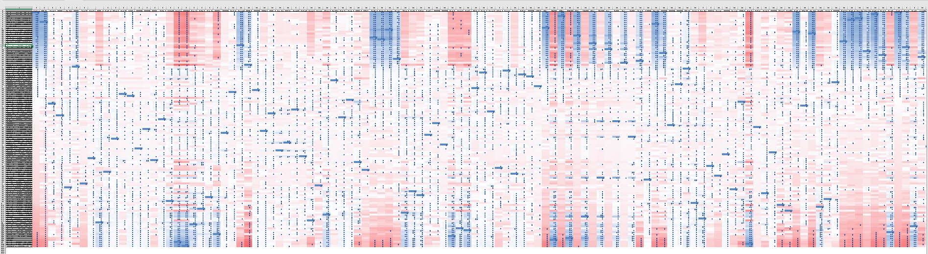
We obtained a table with 121 columns (treatments) and 26712 barcodes
- I kept only the barcodes that were present in all the drugs/columns: 6111 barcodes selected
- I transformed 4 🡪 1 and the rest 🡪 0 (binary) [except for osim three months, 3 replicates]
-Correlation matrix for the treatments

Slide 6
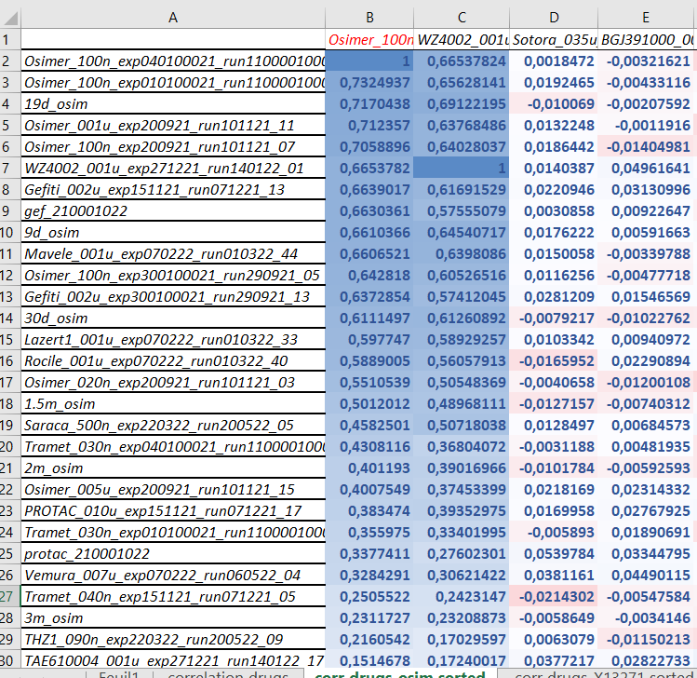

Slide 7
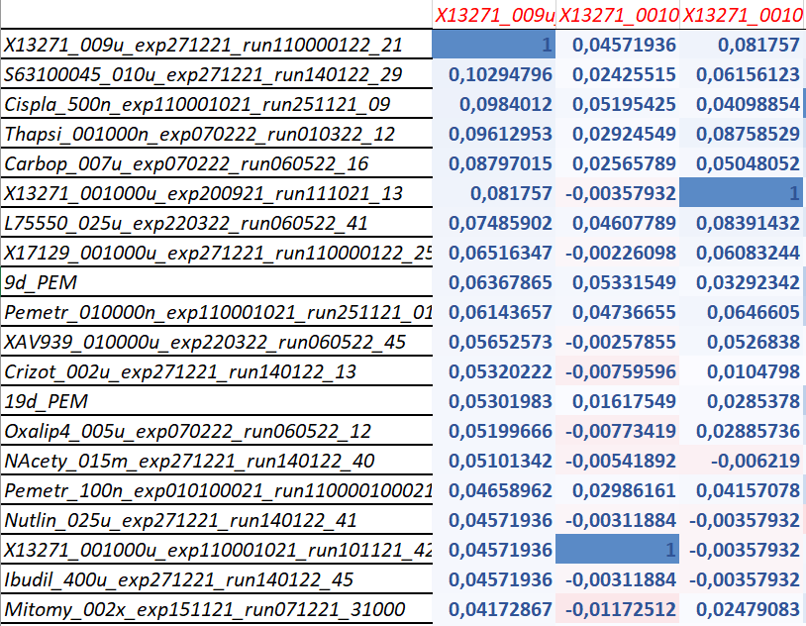
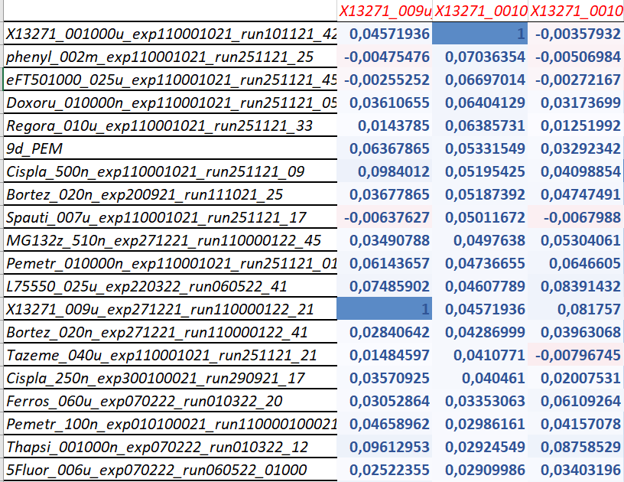
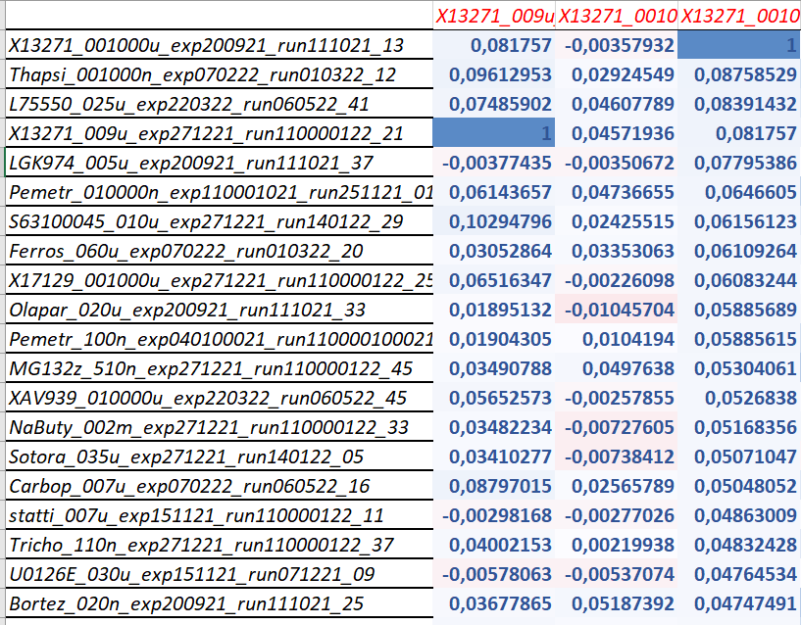

Slide 8
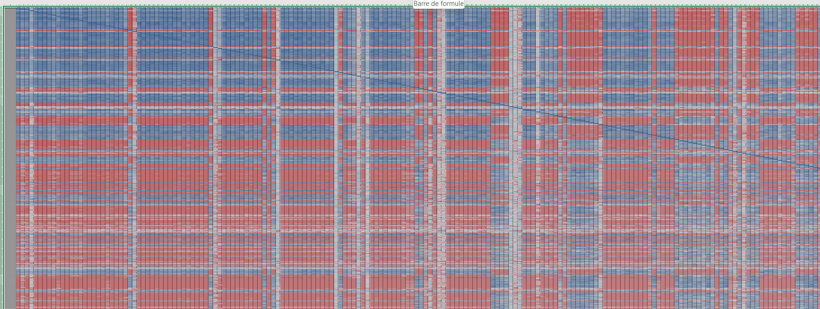
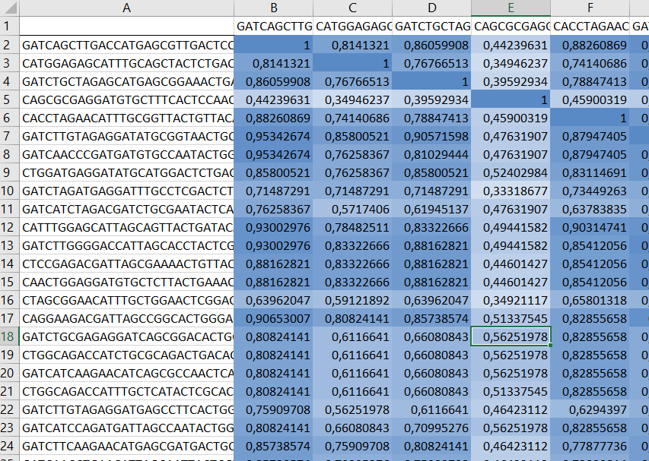
-Correlation matrix for the barcodes
-I selected barcodes displaying a sum of at least 1 🡪 4106 barcodes
-I selected barcodes displaying a sum of at least 10 🡪 657 barcodes

Slide 9
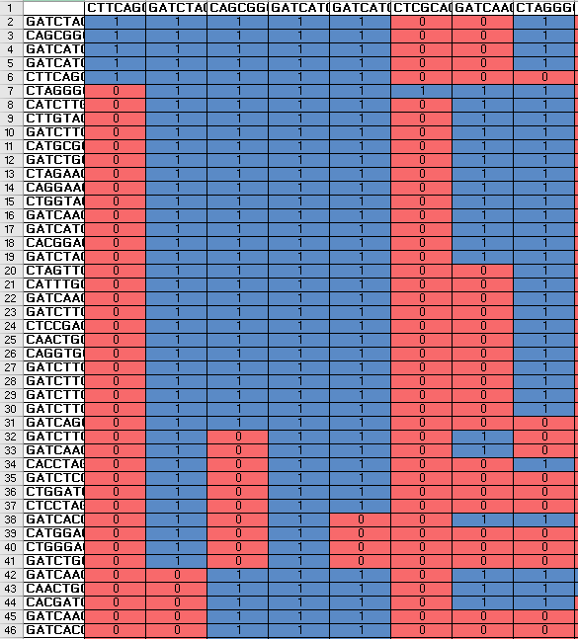
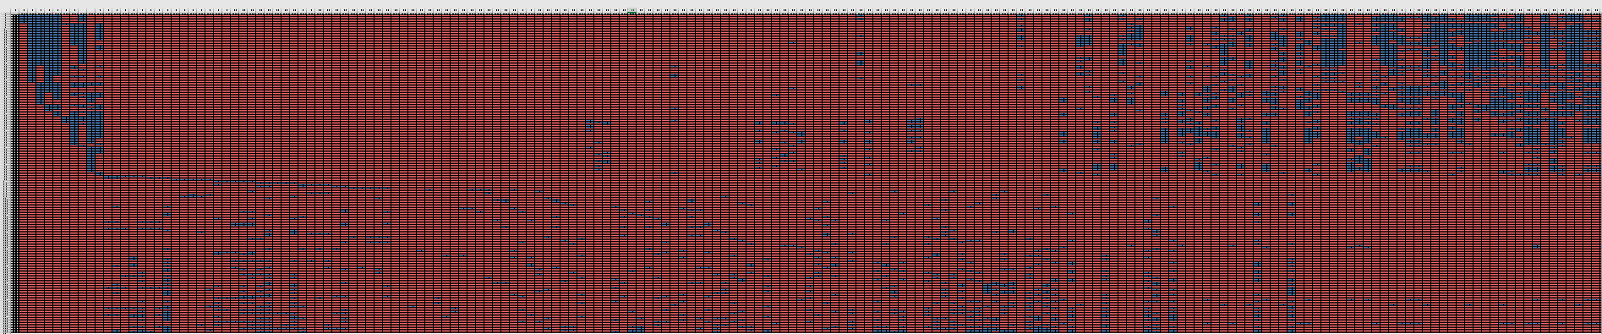
- To select barcodes highly correlated:
CC > 0,8 🡪 1 ; CC ≤ 0,8 🡪 0
- I discarded barcodes with sum < 5 (205 barcodes remaining)

Slide 10
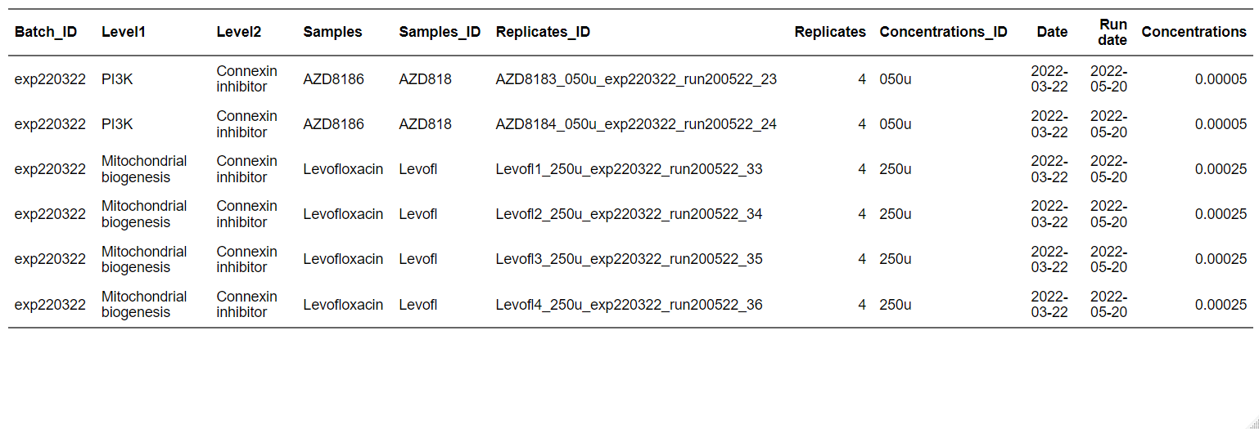
Data management
Final objective: check replicates, set of experiences, concentrations, drug mapping, …
Metadata Barcoding general recommendations: https://mbmg.pensoft.net/article/58056/
Final public database: ENA, NCBI GenBank , CellLine Atlases, arc-virtual-cell-atlas, cellosaurus…
add time course

Slide 11
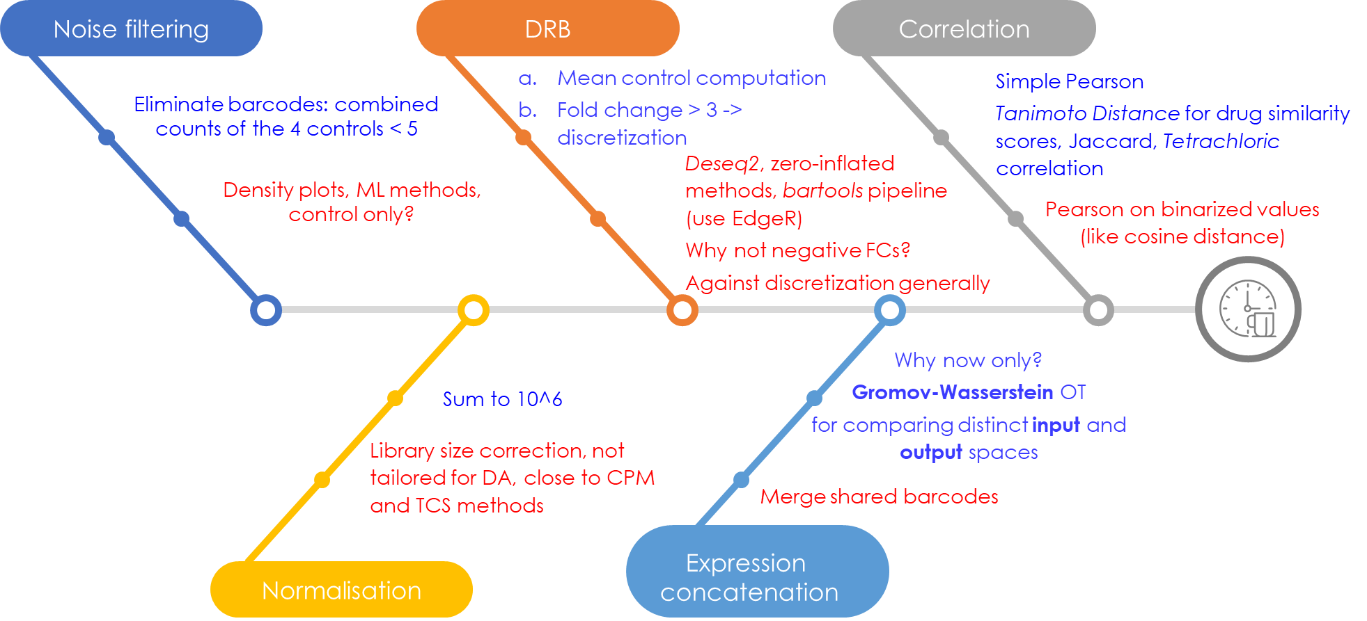
Luca’s Analytical Pipeline
https://www.linkedin.com/posts/shimon-shrem-5411b51_correlation-coefficients-are-powerful-tools-activity-7310311906777473025-CA8a
Phi coefficient
sum
Alternatives for computing similarity scores with binary data: https://cedar.buffalo.edu/papers/articles/CVPRIP03_propbina.pdf
Side Question: how do you generate your infographies :-) ?

Slide 12
Practical aspects
GitHub (privacy, on code snippets, and final output?)
Language R + renv + tidyverse
Reporting: Quarto (docx + html): commenting through Hypothesis (PR for Vera? :-))
Datasets storage and access? Data Tracking with DataLad or DVC ou cellosaurus
Computational resources (IFB core cluster?)
Zotero for sharing biblio resources.
Paper? Position within it.
NDA agreement (which purpose?)
Naming files: https://www.linkedin.com/posts/%F0%9F%8E%AF-ming-tommy-tang-40650014_stop-losing-track-of-your-analysis-files-activity-7311382817110708225-Kl3A (from Ming Tommy Tang)

